Slide 1

Versatility App User Guide
Updated on : 28th May, 2018

Slide 2

Content
4. Backoffice-General Administration and Access Control
11. Backoffice Definitions
13. Creating a Distribution Centre
25. Initiate Process
35. Help

Slide 3

Login

Slide 4

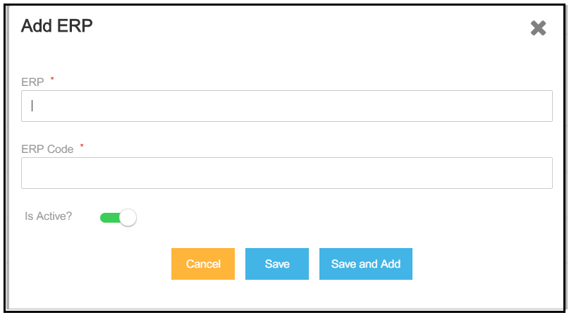

Login Page
1
2
3
4
You can add a list of ERPs to the Pre-packing application from this section. Each ERP should have a Target ID associated which will be used to connect from Leap
Click on ‘Add New ERP’ to add a new ERP to connect with Leap
Enter the ERP Name of the ERP to which the connection has to be established
Add the ERP Target ID required for connection establishment. This ERP code should match with the code at ERP end.
Click on the Save button to save the changes. To add another ERP to the list click on “Save and Add”

Slide 5
Data Management

Slide 6
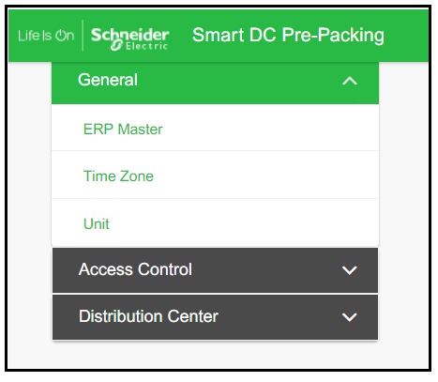
General – Pre-requisites set up for DC Creation
A system admin or the DC Admin can add configurations common across all the DCs, from the General section
The General section at the Back Office gives you the option to add or edit, ERP Master details, Time Zone and Unit Conversion details

Slide 7
General – ERP Master
1
2
3
4
You can add a list of ERPs to the Pre-packing application from this section. Each ERP should have a Target ID associated which will be used to connect from Leap
Click on ‘Add New ERP’ to add a new ERP to connect with Leap
Enter the ERP Name of the ERP to which the connection has to be established
Add the ERP Target ID required for connection establishment. This ERP code should match with the code at ERP end.
Click on the Save button to save the changes. To add another ERP to the list click on “Save and Add”

Slide 8
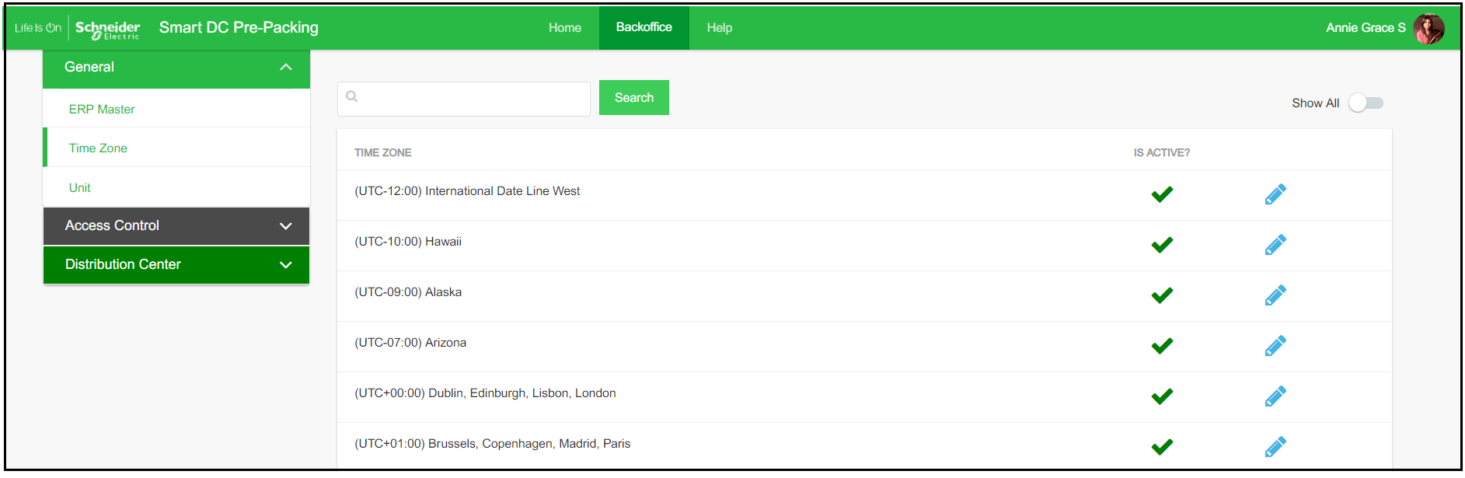
General – Time Zone
Here you can find a list of Time Zones which can be activated to assign to a DC.
A DC can be set to a particular time zone by selecting from the list of time zones. These time zones can be configured by setting them as Active or Inactive
Each DC can be assigned a Time Zone based on which you can view the time in which the process time and audit history time can be viewed
Set the Time Zone from Inactive to Active to make it available for assigning to a DC
Search for a Time Zone by entering the text

Slide 9

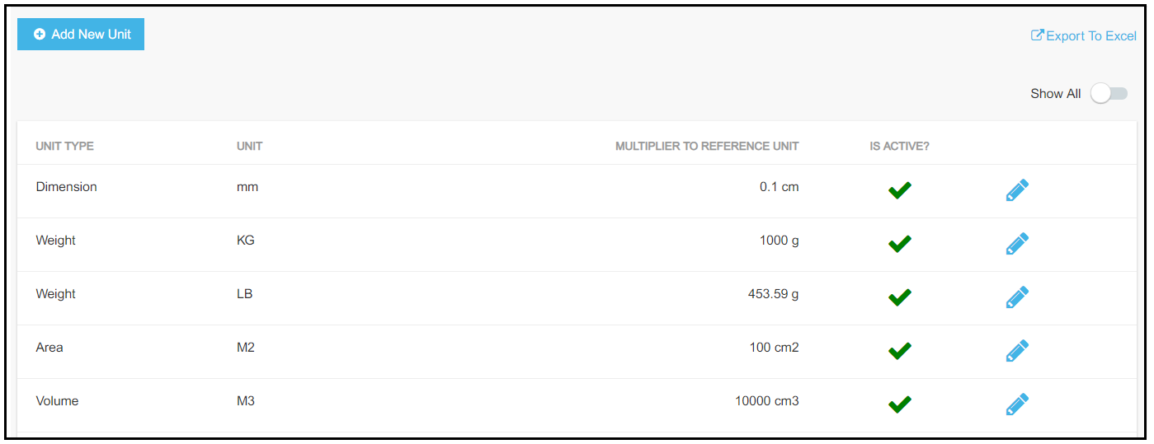
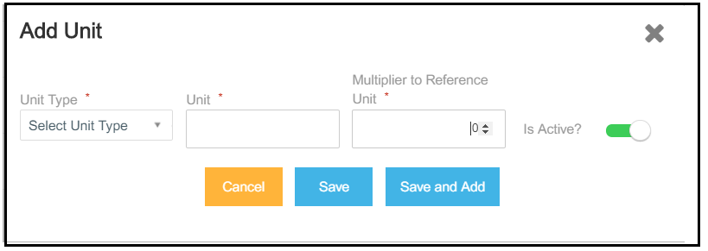
General – Unit
Pre-Packing application allows you to configure the Unit system in which you want to view the results
The units in which you receive the input from ERP can be converted into the units in which you want to view the results on the Pre-Packing application
1
Ensure to set the the input wrt reference unit in cm/g
2
Edit the configurations by clicking on Edit button
Click on Add new Unit to configure a new unit in the Pre-Packing application which is coming from the ERP
Column description
Column Name | Description
Unit Type | The type of unit are the parameters defined for each material as fetched from the ERP Unit Types which you can configure: Area Dimension Volume Weight
Unit | Unit of the above parameters as received from the ERP
Multiplier to Reference Unit | Reference multiplier to convert to cm/g

Slide 10
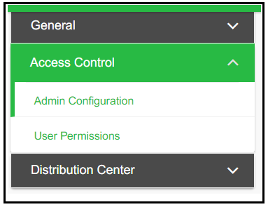
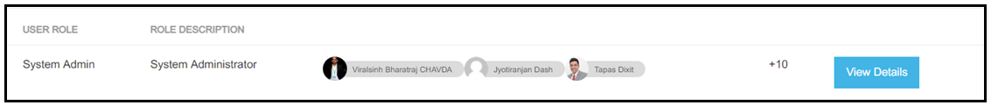
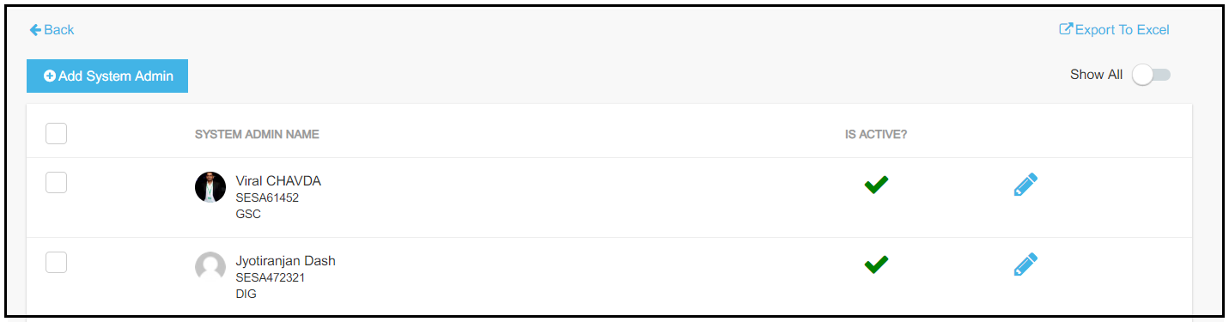
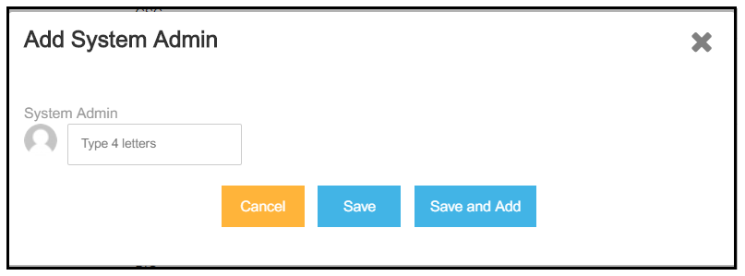
Access Control – Admin Configuration
The System Admins can be configured under “Admin Configuration”
The System Admin has all the rights across the application and has the privilege to add the Pre-Pack Lead and the DC Admin and provide them the required access level
A System Admin can be added by an existing System Admin, however the first System Admin has to be added by the Leap platform team
1
2
3
Click on Add System Admin to add a new user
Click on View Details to Add a new System Admin or View the existing
Search for the required person or SESA ID, select them and save
4

Slide 11
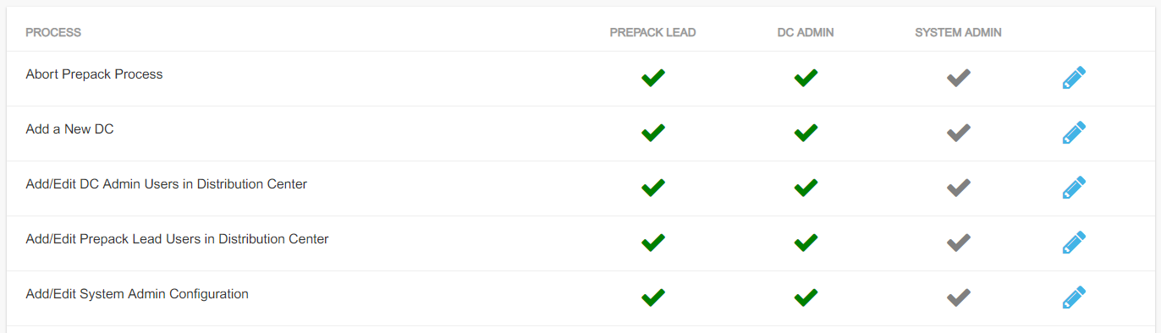
Access Control – User Permissions
1
A user with the privilege to edit User Permission can set up permissions for existing roles by making a access control level active or inactive for each of the roles
According to the current configuration, above shown users will have the specified access in the application for pre-pack process.

Slide 12
Backoffice Definitions

Slide 13
Backoffice- DC Configuration
Exception Location: A location mask coming from SAP which doesn’t match the location mask configured in the DC, then this location can be translated into the DC Location mask format. This location will be used to determine the Packing Group in the Packing Group section
Packaging Type: All the available Packaging Materials available in the DC are configured with the SAP code for each of them for writing back to SAP
Container Type: All the materials in the DC are associated with a set of Package Types in which they can be put together based on the material quantity. Based on the quantity and whether the material comes from a reserve or a non-reserve location, only the best fitting package type will be chosen for the material
Packing Groups: The territorial regions in a DC are grouped into various different Packing Groups for obtaining an optimized packing solution. The line items of a delivery will only be mixed with the line items with the same Packing Group
Trolley Types: The trolley building capability in Pre-Packing application works on the configuration provided in the back office. A Trolley type is defined and mapped to type of picking boxes that can be put on a trolley
Order Box: The Order for choosing the boxes for packing can be configured
Order Trolley: The Order for choosing a Trolley for the boxes which have been processed can be configured
Users: The DC Admin and the DC Pre-Pack lead who will be responsible for the various activities around the Pre-Pack process of the DC can be configured

Slide 14
Creating a Distribution Centre

Slide 15
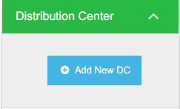
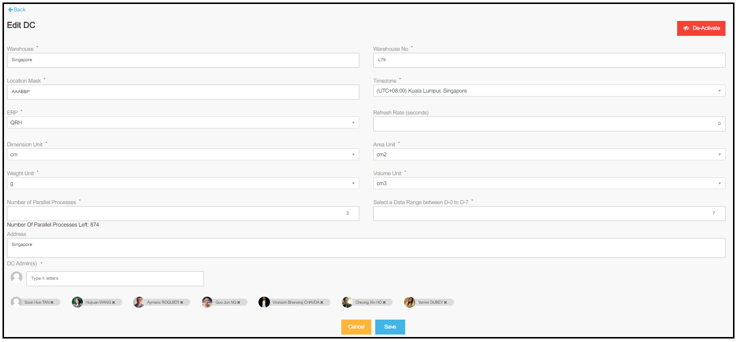
Create a New DC
1
Few important points to note:
Location Mask: All the bin locations fetched from SAP should follow the this convention for calculations
ERP: Target ID to connect with the needed SAP ERP
Refresh Rate: You can set the screen refresh time while running the process
Dimension/ Area/ Weight/ Volume units: Dimensions in which you would want the master data on back office configured
Parallel Process: Number of deliveries which can be written back into SAP at one time
Date Range: The default date range of deliveries on the initiation screen can be set here
2
3
To add a new DC
Click on Backoffice > Distribution center
Choose the Distribution center from the drop down and click on the “Add New DC” button which opens a new screen.
Enter / Choose the basic details like Warehouse, Warehouse No, Time zone, Location mask, ERP ,Units for dimension, area, weight and volume, parallel process Address, Date Range, Address and DC Admin
You can add more than one DC Admin

Slide 16
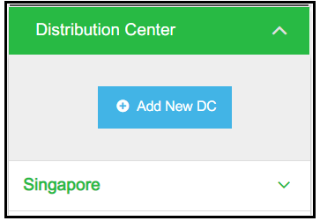
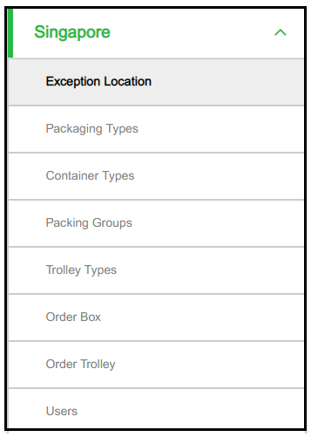
Create a New DC
2
Click on the DC Name to view all the related configurable sections. You can further click on each section on the side menu to make changes to the individual section
1
A new DC once added can be found under the list of Distribution Centers.
You can view a DC only if you are a system admin or added to that DC in nay role (DC admin/pre-pack lead)
Click on the new DC created and click on each of these configurable sections that include :
Exception Location, Packaging Types, Container Types, Packing Groups, Trolley Types, Order Box and Order Trolley

Slide 17
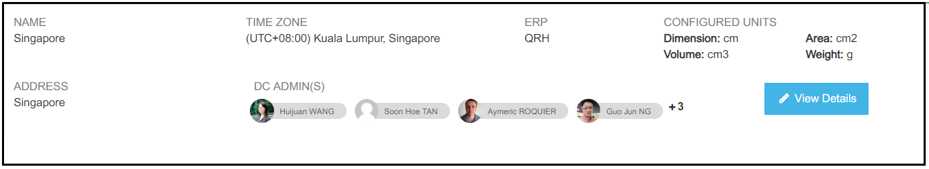
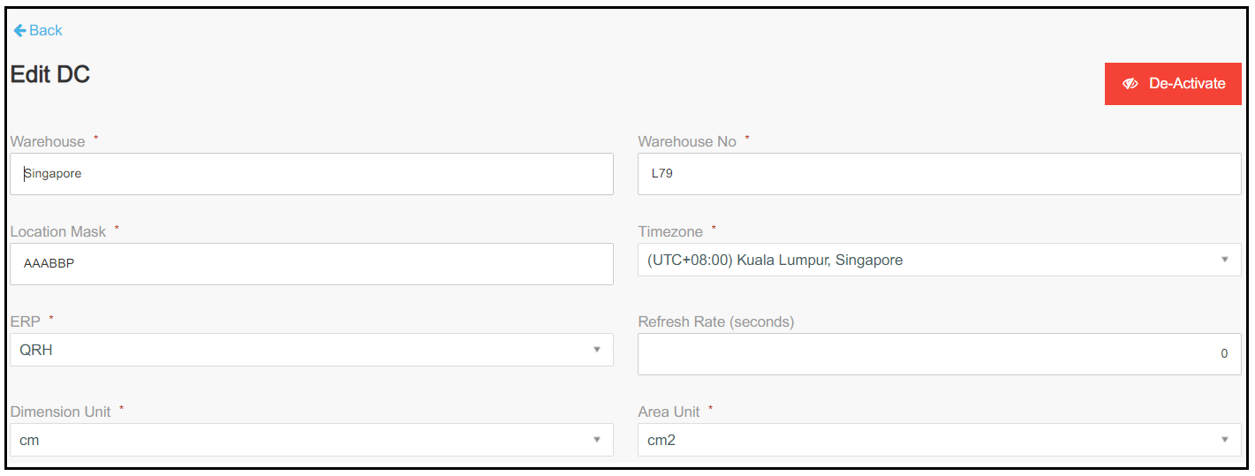
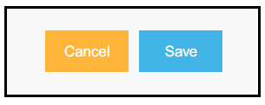
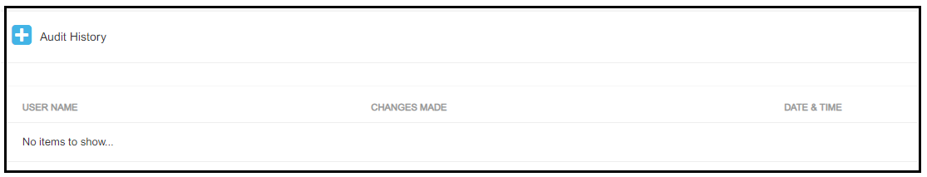
Distribution Center - Details
1
To View/ Edit the details of an existing DC, click on View Details
Make the desired changes on the edit DC screen and click on Save on the bottom of the screen
4
2
3
Audit trail logs can be viewed in the Audit History section, located at the end of the page for each section
In case you want to de-activate an existing DC either if pre-packing process is not valid anymore to the DC or if the DC is not functional anymore etc., click on De-Activate and confirm

Slide 18
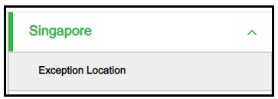
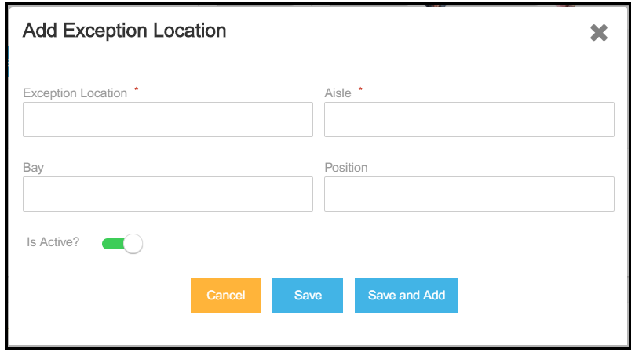
Distribution Center – Exception Location
An exception location needs to be configured when the location coming from SAP does not match the location mask, for example “AAA-BB-P”. The exception location can be broken down into AAA-BB-P and configured so that the Pre-packing application can identify the location and determine the packing group
1
Click on the Exception Location tab on the side menu
Fill in all necessary details in the pop up and click on Save once done
2

Slide 19
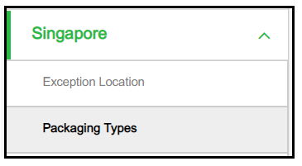
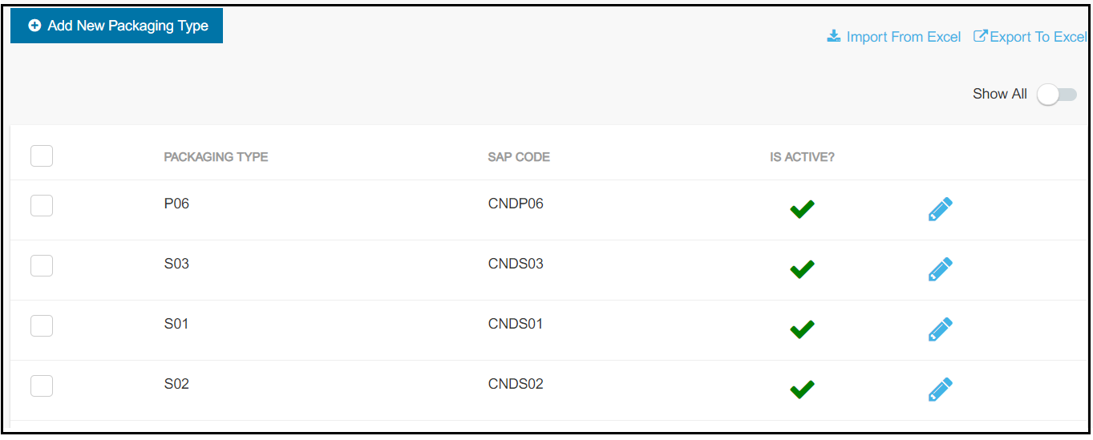
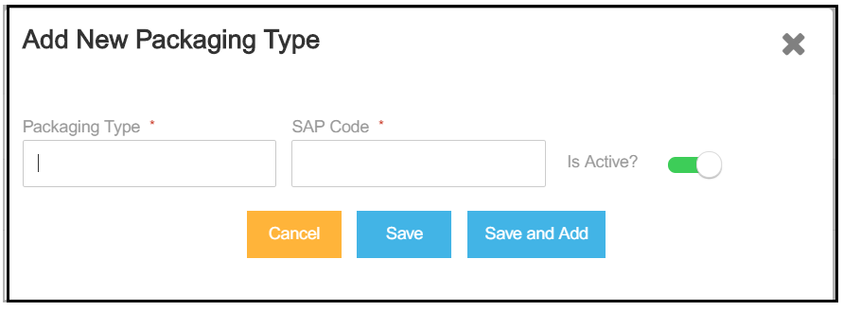
Distribution Center – Package Types
Package Types are the packaging materials used in the DC to pack the item quantities so that they can be made shippable.
The available Package Types in the DC need to be mapped with the associated code in SAP for writing back in SAP.
Click on Add a New Package Type
1
2
Click on the Package Types tab on the side menu
4
Click on the Edit icon to edit the details of the package type
3
Click on Export to download the data. The data can also be imported through an excel file. The template is provided in the link
Enter the details and click on Save

Slide 20
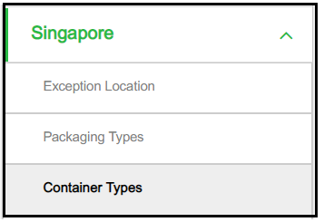
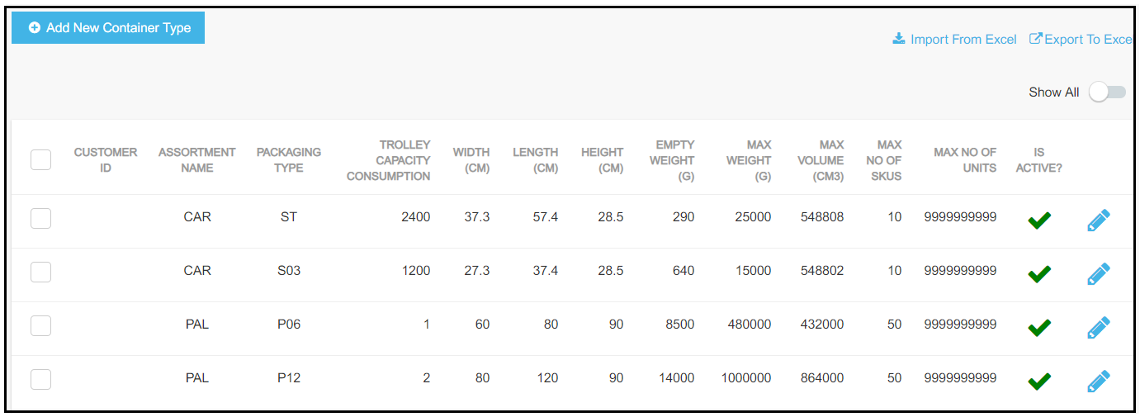
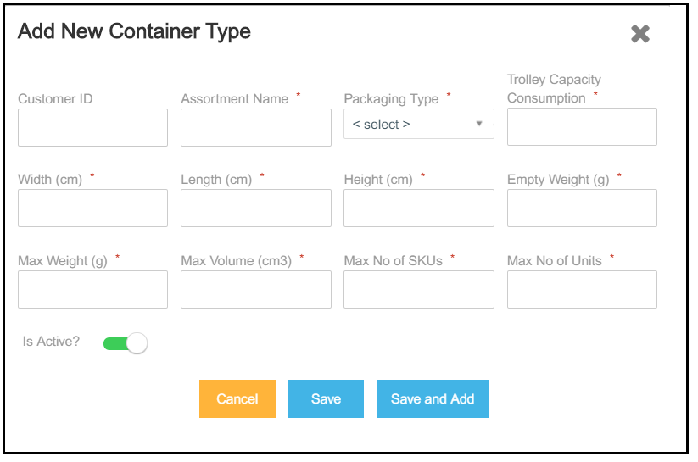
Distribution Center – Container Types
Container Types are the packaging materials used in the DC to pack the item quantities so that they can be made shippable. These are all the Container Types available in the DC which can be used for loose packing
The dimensions for these boxes can be configured on the back office. Please refer to the below screens
Click on Add a New Container Type
1
2
Click on the Container Types tab on the side menu
4
Click on the Edit icon to edit the details of the container type
Any material defined by the assortment type in the Ylomean table is considered for loose packing with these containers
3
Enter the details and click on Save
Click on Export to download the data. The data can also be imported through an excel file. The template is provided in the link
Each Package Type which can accommodate a certain material, will be associated with an Assortment Type in the Ylomean table. The material quantity marked with an Assortment Type is what can be considered for mixed picking process. Any Package Type with no Assortment Type will have to be picked as-is.

Slide 21
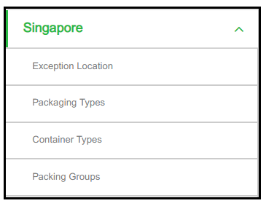
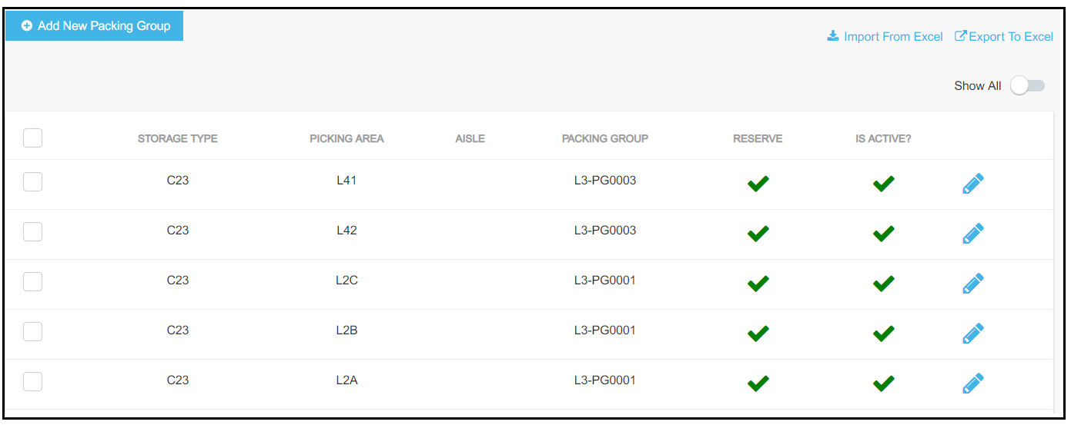
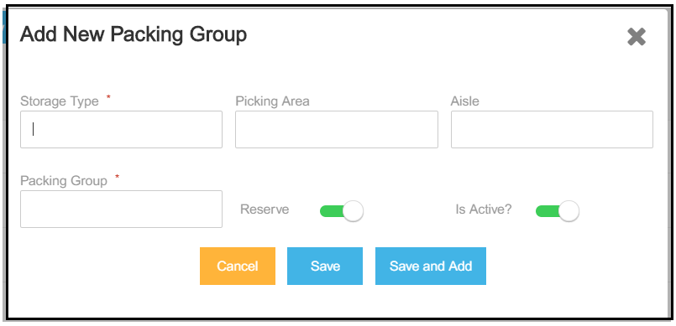
Distribution Center – Packing Group
The territorial regions in a DC are grouped into various different Packing Groups for obtaining an optimized packing solution. The line items of a delivery will only be mixed with the line items with the same Packing Group. This will ensure the items of a territorial region are packed together for a better optimized packing process.
Click on Add a New Packing Group
1
2
Click on the Packing Groups tab on the side menu
4
Click on the Edit icon to edit the details of the Packing Group
3
Click on Export to download the data. The data can also be imported through an excel file. The template is provided in the link
Enter the details and click on Save

Slide 22
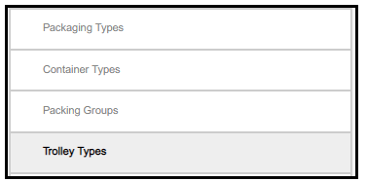
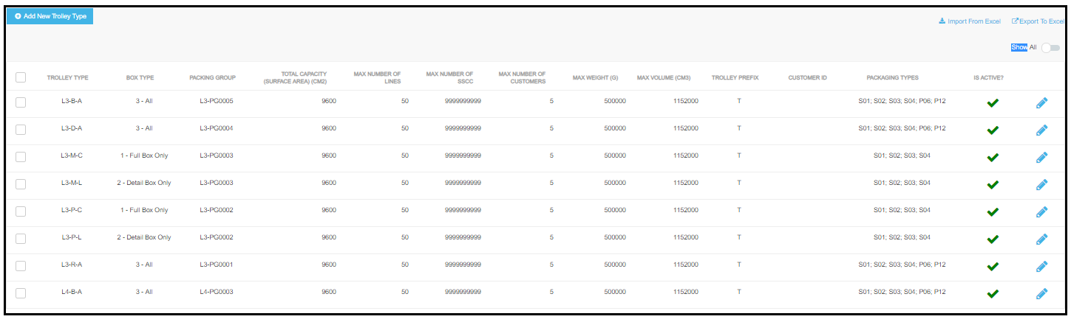
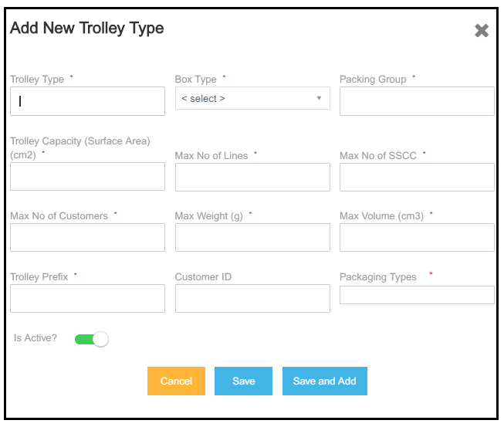
Distribution Center – Trolley Type
All the available Trolley Types in the DC can be configured in this section, with a specific Packing Group and the corresponding Package Types. Based on the configurations, the Trolley Type is matched with the available Trolleys from the T346 table coming from SAP to assign the HUs to the Trolleys
Click on Add a New Trolley Type
1
2
Click on the Trolley Types tab on the side menu
4
Click on the Edit icon to edit the details of the Trolley Type
3
Trolleys are assigned to each of the HU based on the matching configuration and the trolleys available in the T346 table
Click on Export to download the data. The data can also be imported through an excel file. The template is provided in the link
Enter the details and click on Save

Slide 23
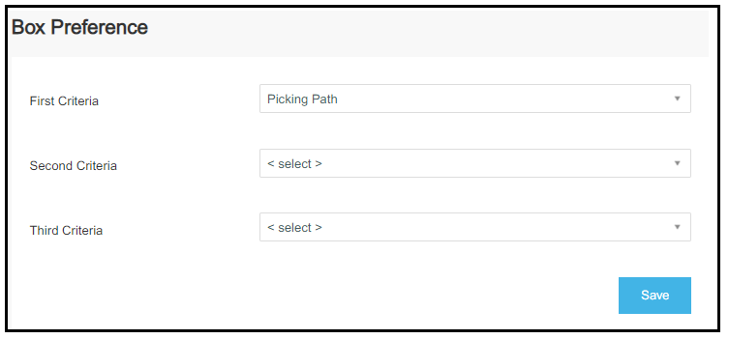
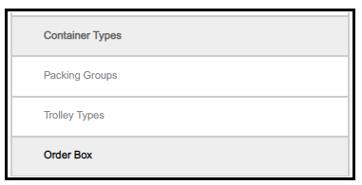
Distribution Center – Box Preference
The Order for choosing the boxes for packing can be configured here. Boxes can be ordered based on:
Picking Path – The nearest items are packed first from each TO line
Descending Weight – Items with highest weight are packed first from each TO Line
Descending Volume – Items with highest volume are packed first from each TO Line
Click on Save to confirm the changes
Click on Order Box on the side menu bar
1
2
Select the criteria on the three levels
3
By default the “Picking Path” is chosen as the first boxing criteria
Three preferences can be set at one time. If the first criteria is volume, the second criteria is weight, and there are two items of the same volume then the item with the items will first be sorted by volume then by weight

Slide 24
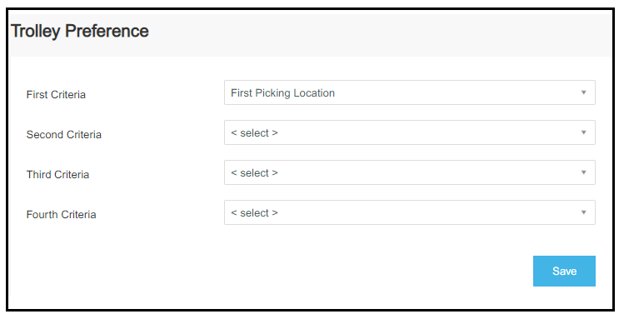
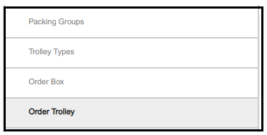
Distribution Center – Trolley Preference
The Order for choosing a Trolley for the boxes which have been processed
First Picking Area – The items are sorted by the picking area and assigned to the trolley
First Picking Location– The items are sorted by the picking location and assigned to the trolley
Number of Lines– Boxes to be assigned a trolley are sorted with the descending number of picking lines in them
Number of Visited Picking Area - The items are sorted by the most frequently visited picking areas and assigned to the trolley
Select the criteria on the three levels
1
2
Select the criteria on the three levels
3
Click on Save to confirm the changes
Four preferences can be set at one time. If the first criteria is picking location, the second criteria is picking area, the boxes with the nearest area in same location will be processed for the trolley
By default the “First Picking Area” is chosen as the first Trolley Building criteria

Slide 25
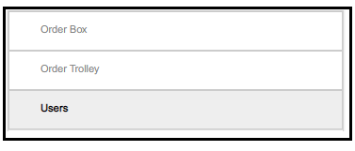
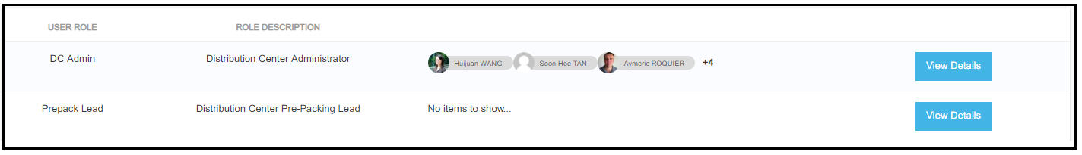
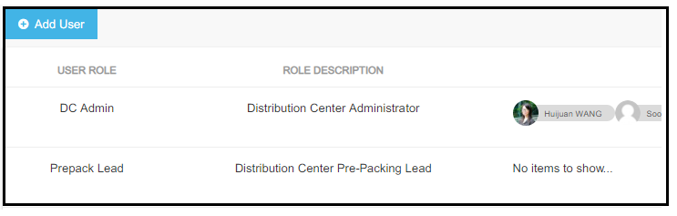
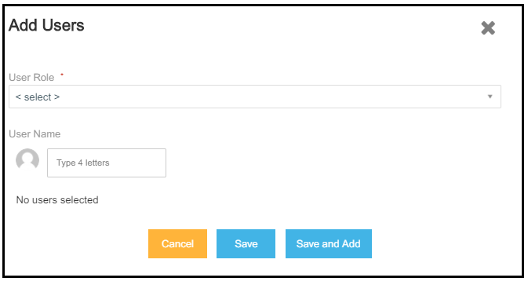
Distribution Center – Users
Each DC will have two user roles; The DC Admin and the DC Pre-Pack lead who will be responsible for the various activities around the Pre-Pack process
The System Admin has all the rights across the application and has the privilege to add the Pre-Pack Lead and the DC Lead and provide them the required accesses
The roles and responsibilities of both the roles can be controlled through the Access Control function in the Back Office
1
Click on Users on the side menu
2
3
Click on Add User to add a new user
Click on View Details to view or edit a DC Admin or DC Pre Pack Lead
Search for the required person or SESA ID, select them and save
4

Slide 26
Initiate Process

Slide 27
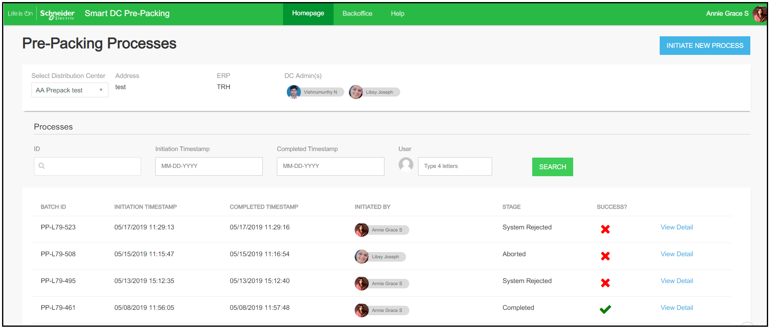
Home
You can search for the required data with Search Criteria:
Process ID: You can provide a Process ID for reference
Initiation and Completed Timestamps: To views the processes run in a given time period
User: Search with the name of the user who initiated the process
Click on Search button shown above and the search results will be displayed here
Click on View Detail to view the Process Details
When you launch the Pre-pack tool URL, you will see the above landing page. This page is the summary of all the processes which have been run for the above selected DC
If you belong to only one DC, by default the data of the DC will be displayed, if not you have the choice to select the DC from the dropdown for which you want the data

Slide 28
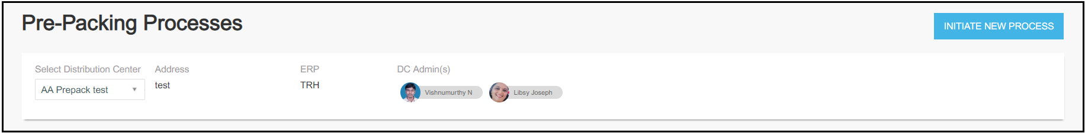
Initiate New Process
A Pre-Pack process can be run to optimize the containers used for packing the inventory in a DC. For the optimization, items are first fully filled into the available containers and the remaining partially filled containers are further mixed together to minimize the containers used for packaging
The packaging of the items in the containers is made based on the Packaging Groups. The Packaging Groups are territorial areas denoted with a code. Only the items belonging to the same Packaging Group will be mixed together for better time optimization.
The items of a Delivery are processed by each TO line. And the items of each delivery are only mixed together so that the right items reach the right customer
Points to Note:
Only one Pre-Pack Process can be run at one time per DC

Slide 29
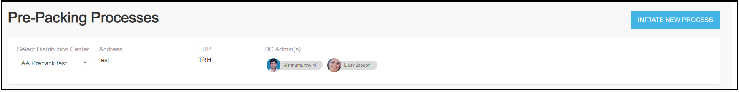
Initiate New Process
A user added to the Pre-Pack tool, with access to “Initiate Prepack Process” should be able to launch the Pre-pack tool and click on “Initiate New Process” to start the Pre-pack process.
1
2
If a user is added to multiple DCs, they should choose the required DC from the “Select Distribution Center” drop-down and then click on “Initiate Process”

Slide 30
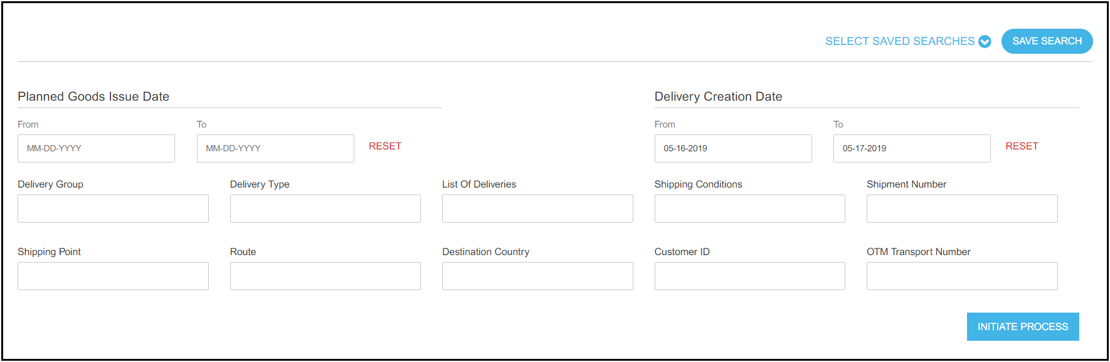
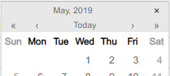
Initiate New Process – Advance Search
1
A process can be initiated with the Delivery Creation Date, which is mandatory along with one of the Advance Search criteria shown below
By default the date range selected is from the previous day to present day. Click on the field to fetch the calendar and make the date change
1
2
3
2
To use the Advance Search fields, input the search parameter in the field (s) and press Enter to confirm
3
Once done, click on “Initiate Process” to start the Pre-Pack process

Slide 31
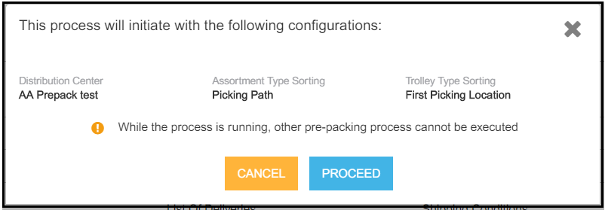
Initiate New Process - Confirmation
1
A confirmation pop-up message is displayed on the screen once the Initiate process button is clicked on the Advance Search page
3
2
Clicking on Cancel you will be redirected to the Advance Search page for making any changes
4
Click on Proceed to confirm & Start the Pre-pack process for the selection made
Details displayed in the confirmation pop-up:
2
Distribution Center: The DC for which is the Pre-Pack process has been initiated
3
Assortment Type Sorting: Displays the selection made in the Box Preference as selected in the Order Box sub-menu in the Back office of the Pre-Packing application. This sorts the ordering of the boxes during the Pre-Pack process based on the user selection. Refer to for further details on making changes to the selection.
4
Trolley Type Sorting: Displays the selection made in the Trolley Preference as selected in the Order Trolley sub-menu in the Back office of the Pre-Packing application. This sorts the ordering of the trolleys during the Pre-Pack process for trolley assignment based on the user selection. Refer to for further details on making changes to the selection.

Slide 32
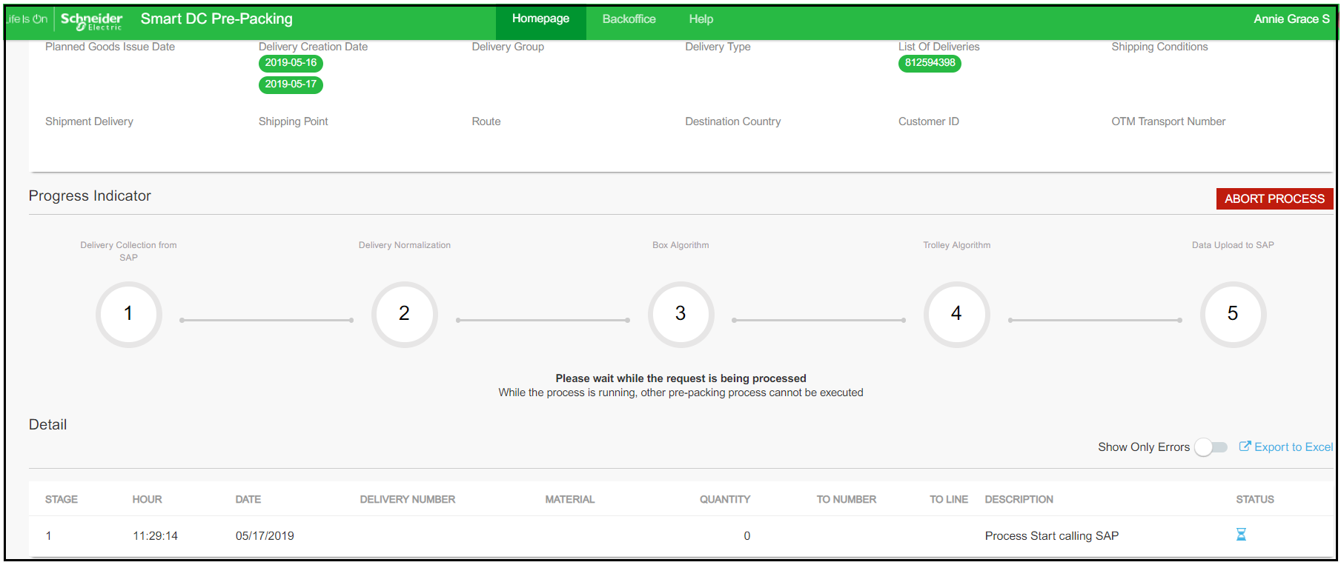
Process Details
Once the Pre-pack process is initiated, you can view the progress and the details of the process being run the Process Detail page
You can view all the applied advance search criteria in the Search Filter section
Abort Process – This button when clicked will abort the process which is in progress. The integrated ERP will not be updated with the processed data.
Points to Note:
Each process has a unique ID which is represented by the Process ID: PP-Warehouse ID-#
Example: PP-L79-71
The Progress Indicator gives the details of the stage in which the process is currently. There are 5 stages to complete the process.
The Process Details section gives the details about the deliveries being processed for each individual step.

Slide 33
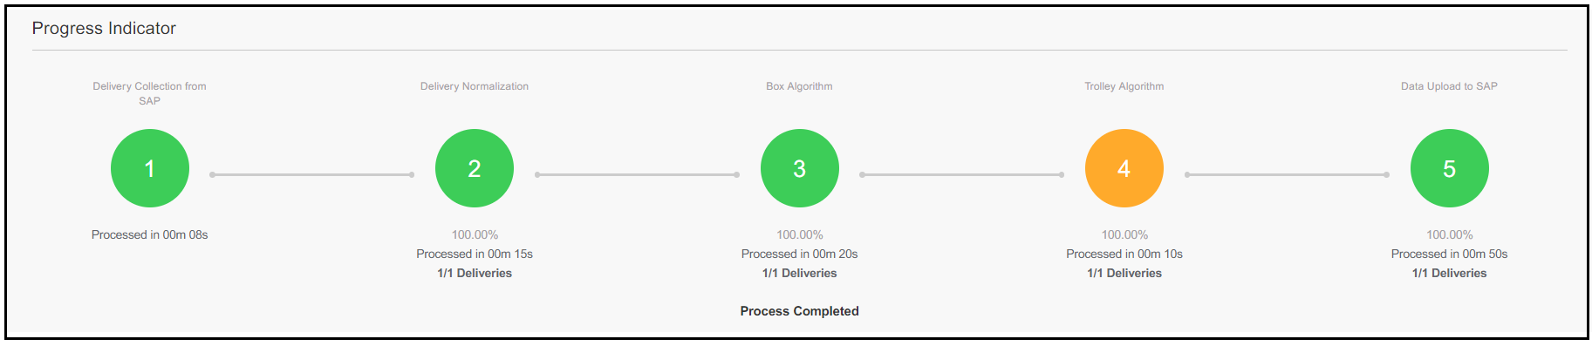
Process Details – Progress Indicator
Stage | Description
1 – Delivery Collection from SAP | This stage marks the fetching of deliveries from the integrated ERP based on the search criteria provided in the Initiation stage
2 – Delivery Normalization | Data Normalization is a system executed step when the information being stored in Leap DB is normalized along some rules to make it ready for Boxing Each TO item of a delivery is processed at one time All the dimensions received for materials are converted to the dimensions according to the DC configuration Based on whether the TO item comes from a Reserve or Non Reserve location, the respective algorithm is applied and items are mapped with containers based on best fit If materials are to be packed as-is based on Ylomean assortment, items are added to a package type and it is closed and marked with an HU ID and sent for Trolley building algorithm Materials which can be mixed, based on the Ylomean assortment are sent to the next stage for boxing algorithm
3 – Box Algorithm | Materials of a delivery & the same Packaging Group can be mixed together by following the best fit rule. The boxes are mixed together to optimize the number of containers being used and the containers are marked for closing The containers are then assigned an HU ID and sent for Trolley building Algorithm
4 – Trolley Algorithm | The HUs are then assigned with the available Trolleys based on the configuration provided in the back-office of the Pre-packing tool Each HU is assigned a Trolley, if a trolley is not available for any reason, it is shown in the details section
5 – Data Upload in SAP | The HUs which are mapped with the Trolleys are sent to be written into the integrated ERP
Legends
All deliveries processed
Partially processed deliveries
All deliveries failed
Please Note:
You can click on each stage to view only the details of the stage
Multiple stages can be selected at one time
Status of the process is displayed below the stages

Slide 34
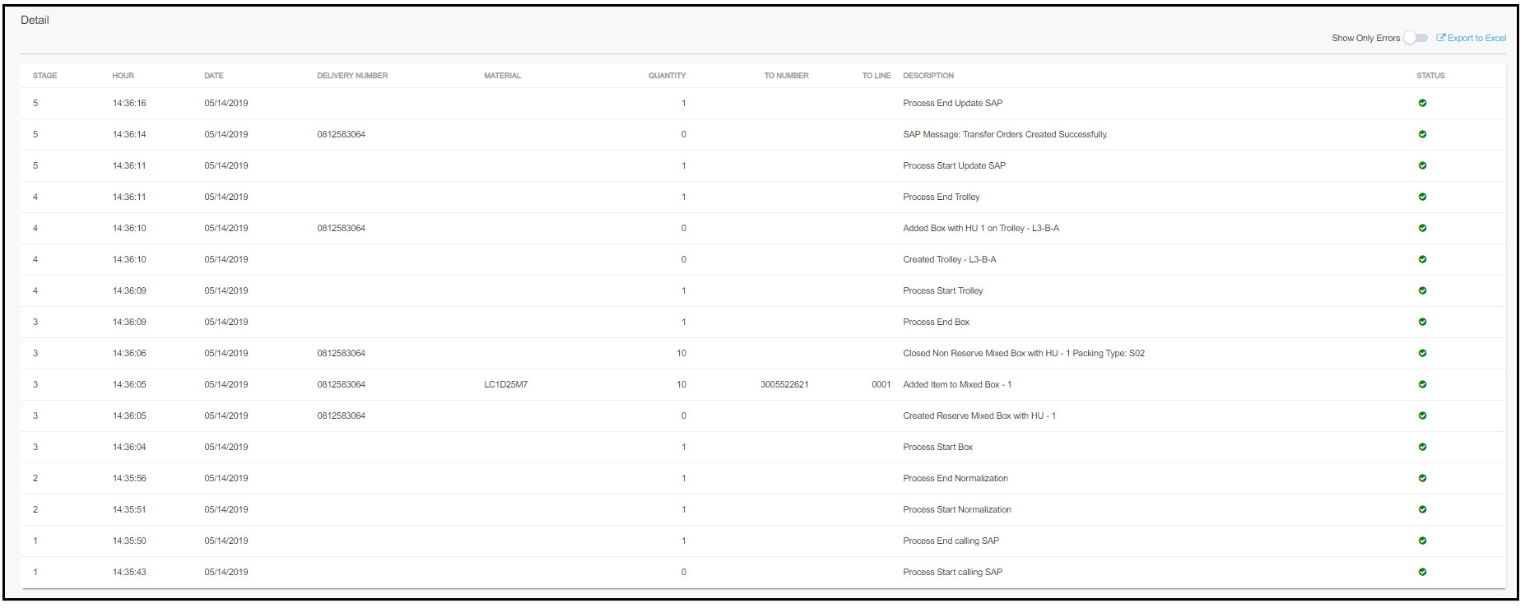
Process Details – Detail Section
Details of the process initiated can be viewed in this summary section. You can find the clear description of each stage in each line
Status Legends
Please Note:
You can download the details by clicking on “Export to Excel”.
Click on “Show Errors Only” to view only the errors incurred
Click on Export to download the data. The data can also be imported through an excel file. The template is provided in the link
Completed successfully
Failed
In Progress

Slide 35
Process Details – Detail Section
How to read the summary section:
Column Name | Description
Stage | This is the stage of the process
Hour | Time at which the given stage of the process was executed
Date | Date on which the process was initiated
Delivery Number | Details of the delivery being executed for the stage of the process This can be empty when the delivery number is not applicable for a certain stage of the process; example, Calling SAP
Material | Details of the material being executed for the stage of the process This can be empty when the delivery number is not applicable for a certain stage of the process; example, Calling SAP
Quantity | The quantity of the items or deliveries being processed for the stage
TO Number | TO Number ID of the TO being processed
TO Line | TO Line ID of the TO being processed
Description | This provides the detailed description of each process of each stage
Status | Shows if the process of the stage is in progress, failed or completed

Slide 36
HELP

Slide 37
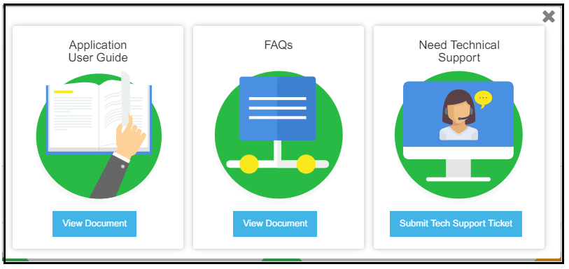
HELP
Need Help?
Please click on the help section of the portal which will give you host of resources to help you speed up with the usage of the application.
This section comprises of :
Application user guide
FAQ
Need Technical Support

